Slide 1
Learning how to perform ETL data migrations with open source tool Embulk
Jason Bell - DeskHoppa : Strata Conference London 2019

Slide 3
Hosts can rent out their desks.
Guests can book them.

Slide 4

That Awkward About Me Slide
I’m a Machine Learning and Data Engineer for hire.
BigData - Spark, Hadoop etc
Kafka, KSQL, Streaming API
Clojure, Java and Python Development
Teach data things.
Wrote a book for Wiley, plotting the second edition.
Twitter: @jasonbelldata

Slide 5
That Awkward About Me Slide
Tweeting, heckling, photography and random stuff is actively encouraged. Please use the hashtag #stratadata
Twitter: @jasonbelldata

Slide 6
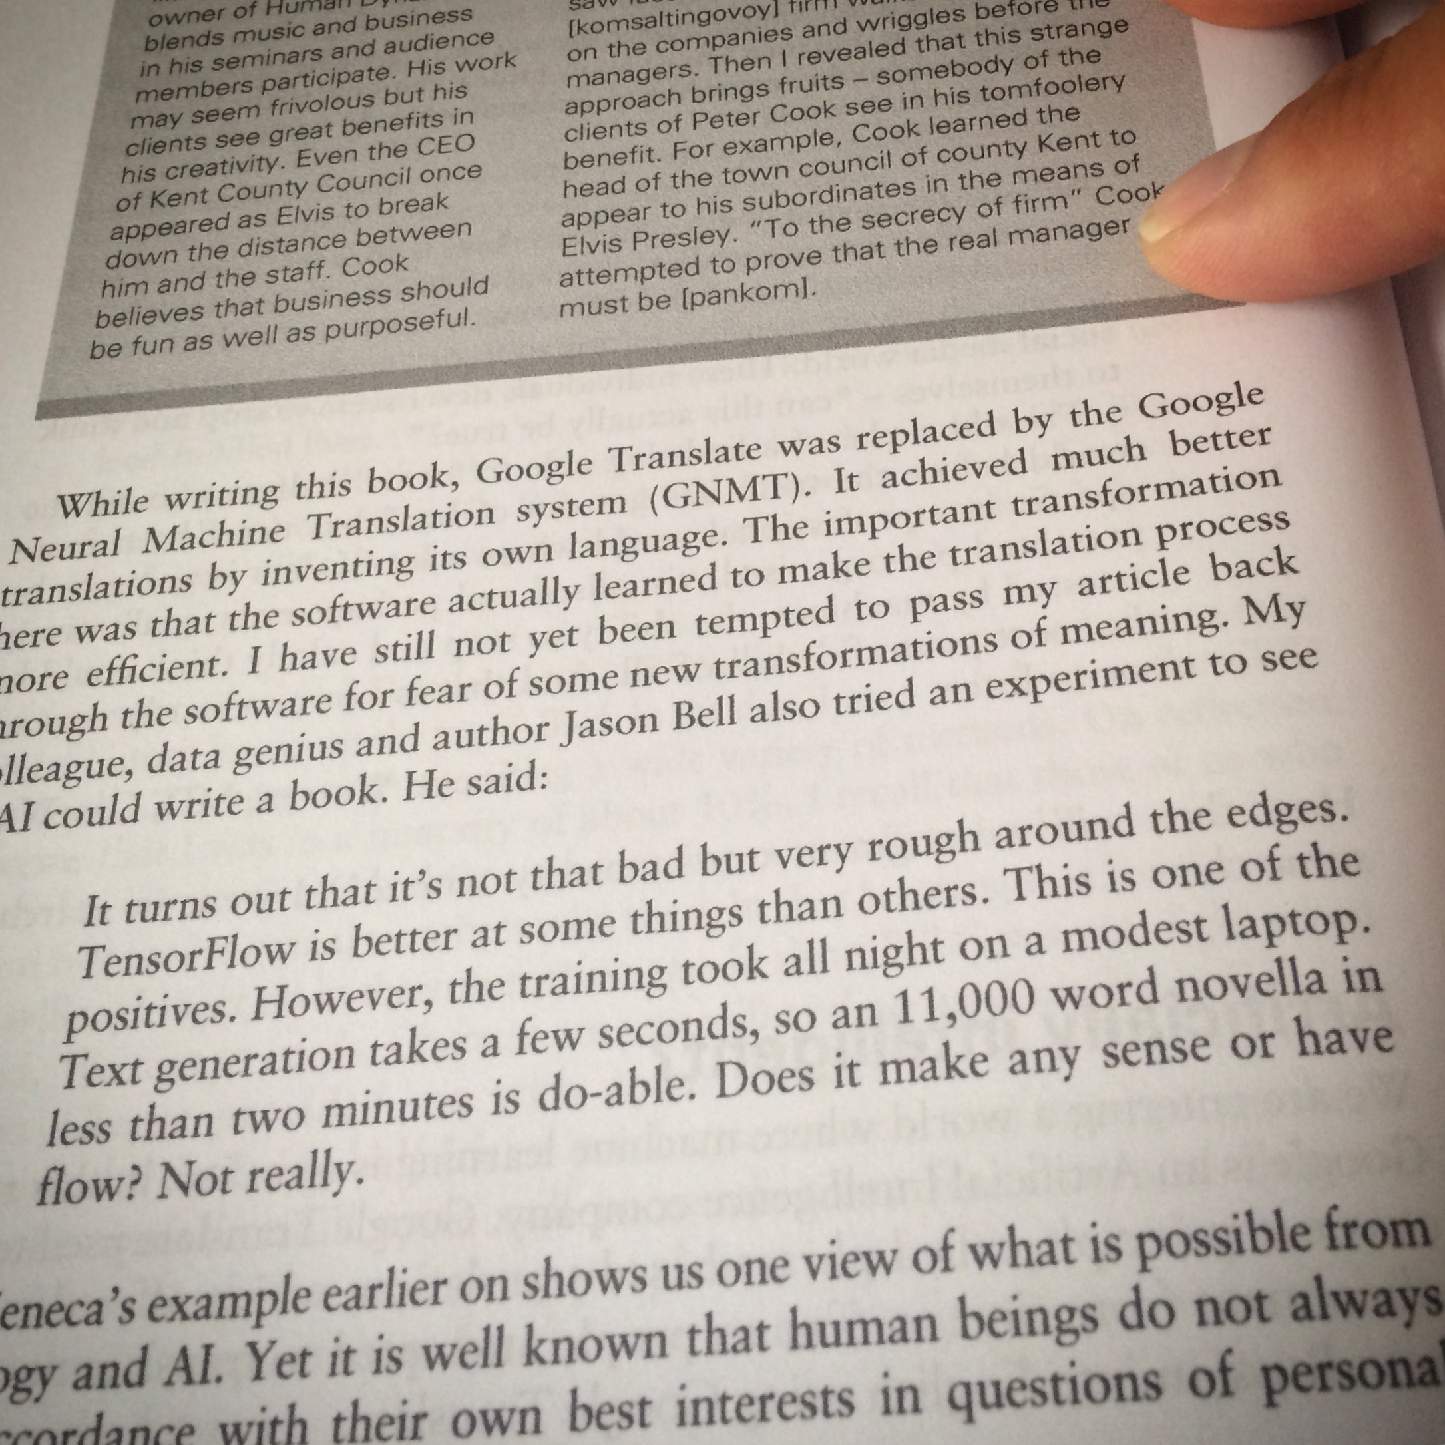

That Awkward About Me Slide
If it’s in print it must be true!

Slide 7

What is Embulk?

Slide 8
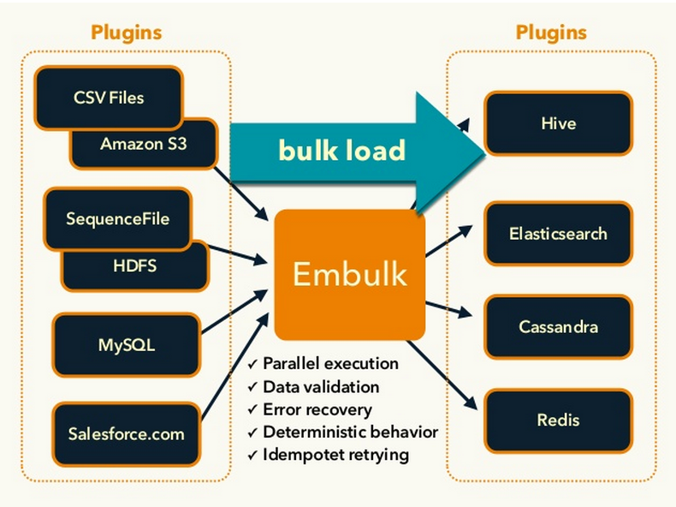
What is Embulk?

Slide 9
Installing Embulk

Slide 10
Installing Embulk
$curl --create-dirs -o ~/.embulk/bin/embulk -L "https://dl.embulk.org/embulk-latest.jar"
$chmod +x ~/.embulk/bin/embulk
$echo 'export PATH="$HOME/.embulk/bin:$PATH"' >> ~/.bashrc
$source ~/.bashrc

Slide 11
A Quick Run

Slide 12
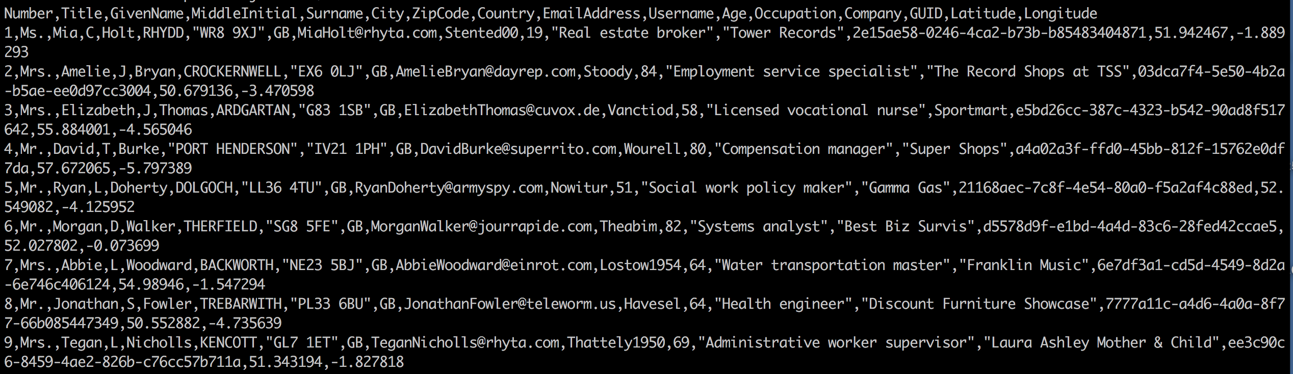
A Quick Run
Generated fake name data from fakenamegenerator.com

Slide 13
A Quick Run
Create a simple configuration file, simpleconfig.yml
in:
type: file
path_prefix: '/home/jason/./embulkdata/sample_'
out:
type: stdout

Slide 14
A Quick Run
Let Embulk generate the required file settings.
$embulk guess ./embulkscripts/sampledata/simpleconfig.yml \
-o config.yml

Slide 15
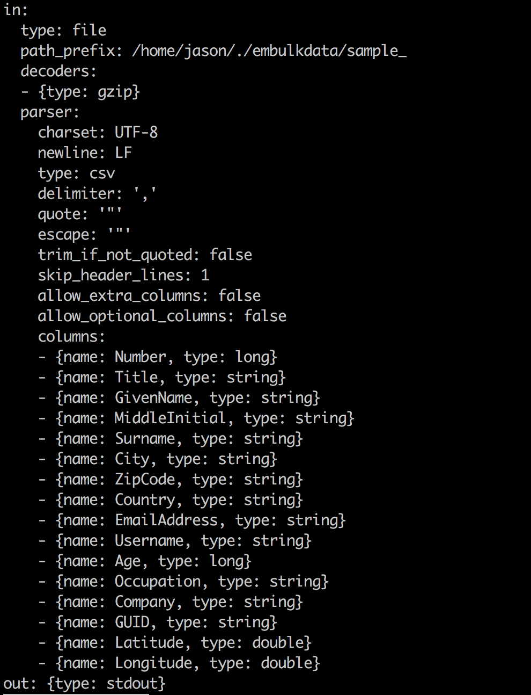
A Quick Run
Embulk creates a config file with the
settings of the input data file.

Slide 16
A Quick Run
Embulk creates a config file with the
settings of the input data file.
Run this config file with Embulk:
embulk run config.yml

Slide 17
A Quick Run
Video has been removed.

Slide 18
Installing Plugins

Slide 19
Installing Plugins
https://plugins.embulk.org
Input Plugins: eg MySQL, Postgres, S3 bucket, MongoDB
Output Plugins: eg BigQuery, Redshift, S3, ElasticSearch
Filters: Hash, Flatter JSON, Google Translate
Parsers: Avro, XML, JSON, Regexp
Decoder/Encoders: File based actions, non standard UTF8 removal.
Executors: MapReduce Jobs

Slide 20
Installing Plugins
To install a plugin.
$embulk gem install <embulk-plugin-name>
$embulk gem list

Slide 21

A quick note on parallel execution.
MapReduce plugin built for Hadoop YARN 2.6.0
It also works on YARN 2.4.0
It’s no longer supported on Embulk 0.9.18 but will be supported again in 0.10 if there is community support.

Slide 22
Scenario 1: File to Database

Slide 23

There is a meeting……..
Scenario 2: Database to Data Warehouse
Photo by Campaign Creators on Unsplash

Slide 24
Can we migrate millions of CSV files to our MySQL database Jase?
Scenario 2: Database to Data Warehouse
MySQL is the biz! Etc etc
Photo by Campaign Creators on Unsplash

Slide 25

Photo by Campaign Creators on Unsplash

Slide 26

Photo by Campaign Creators on Unsplash

Slide 27
Whooooa there!

Slide 28
Scenario 1: File to Database
Some ratings data I want to move from file to MySQL
$ head -n 10 output.csv
548,5,3.0,857405447
292,1721,4.5,1140051202
73,3706,4.5,1464750953
378,95873,3.5,1443294223
165,1393,5.0,1111612302
553,59369,3.0,1423010662
104,42738,3.5,1446674082
283,6296,3.0,1115170015
548,544,3.0,857407872
353,1220,3.0,1157420794

Slide 29
Scenario 1: File to Database
Install the MySQL Output Plugin
$ embulk gem install embulk-output-mysql
2019-01-01 01:01:01.000 +0100: Embulk v0.9.17
Gem plugin path is: /home/jason/.embulk/lib/gems
Fetching: embulk-output-mysql-0.8.2.gem (100%)
Successfully installed embulk-output-mysql-0.8.2
1 gem installed

Slide 30
Scenario 1: File to Database
Prepare a simple configuration.
in:
type: file
path_prefix: '/home/jason/./work/embulkscripts/sampledata/scenario1/output'
out:
type: mysql
host: localhost
user: root
password: xxxxx
port: 3306
table: scenario1
database: embulktest
mode: insert
Let Embulk do the work on the input file with embulk guess

Slide 31
Scenario 1: File to Database
Confirm the config.yml is correct.
in:
type: file
path_prefix: /home/jason/./work/embulkscripts/sampledata/scenario1/output
parser:
charset: UTF-8
newline: CRLF
type: csv
delimiter: ','
quote: '"'
escape: '"'
trim_if_not_quoted: false
skip_header_lines: 1
allow_extra_columns: false
allow_optional_columns: false
columns:
- {name: userid, type: long}
- {name: itemid, type: long}
- {name: rating, type: double}
- {name: timestamp, type: long}
out: {type: mysql, host: localhost, user: root, password: admin, port: 3307, table: scenario1,
database: embulktest, mode: insert}

Slide 32
Scenario 1: File to Database
embulk run config.yml
Video has been removed.

Slide 33
Scenario 2: Database to Data Warehouse

Slide 34
Scenario 2: Database to Data Warehouse
Install the Redshift output plugin.
$ embulk gem install embulk-output-redshift
2019-01-01 01:01:01.000 +0100: Embulk v0.9.17
Gem plugin path is: /home/jason/.embulk/lib/gems
Fetching: embulk-output-redshift-0.8.2.gem (100%)
Successfully installed embulk-output-redshift-0.8.2
1 gem installed

Slide 35
Scenario 2: Database to Data Warehouse
Create a configuration file.
MySQL -> Redshift
in:
type: mysql
host: localhost
user: myuser
password: ""
database: my_database
table: my_table
select: "userid, itemid, rating, timestamp"
where: "timestamp > 1556454908"
order_by: "userid ASC"
out:
type: redshift
host: xxxxxxxxxxx.eu-west-1.redshift.amazonaws.com
user: pg
ssl: enable
password: ""
database: your_database_name
table: your_table_name
aws_access_key_id: XXXXXXXXXX
aws_secret_access_key: XXXXXXXXXXX
iam_user_name: my-s3-read-only
s3_bucket: embulk-transfer-bucket
s3_key_prefix: tmp/rsdw
options: {loglevel: 2}
mode: insert_direct

Slide 36
Scenario 2: Database to Data Warehouse
Then someone has yet another meeting……..
Photo by Campaign Creators on Unsplash

Slide 37
Scenario 2: Database to Data Warehouse
Can we migrate data from MySQL to BigQuery Jase?
Google Compute is the biz! Etc etc
Photo by Campaign Creators on Unsplash

Slide 38
Photo by Campaign Creators on Unsplash

Slide 39
Photo by Campaign Creators on Unsplash

Slide 40
Whooooa there!

Slide 41
Scenario 2: Database to Data Warehouse
Install the BigQuery output plugin.
$ embulk gem install embulk-output-bigquery
2019-01-01 01:01:01.000 +0100: Embulk v0.9.17
Gem plugin path is: /home/jason/.embulk/lib/gems
Fetching: declarative-option-0.1.0.gem (100%)
Successfully installed declarative-option-0.1.0
Fetching: declarative-0.0.10.gem (100%)
Successfully installed declarative-0.0.10
Fetching: uber-0.1.0.gem (100%)
Successfully installed uber-0.1.0
Fetching: representable-3.0.4.gem (100%)
Successfully installed representable-3.0.4
Fetching: retriable-3.1.2.gem (100%)
Successfully installed retriable-3.1.2
Fetching: public_suffix-3.0.3.gem (100%)
Successfully installed public_suffix-3.0.3
Fetching: addressable-2.6.0.gem (100%)
Successfully installed addressable-2.6.0
Fetching: mime-types-data-3.2019.0331.gem (100%)
Successfully installed mime-types-data-3.2019.0331
Fetching: mime-types-3.2.2.gem (100%)
Successfully installed mime-types-3.2.2
Fetching: jwt-2.1.0.gem (100%)
Successfully installed jwt-2.1.0
Fetching: multi_json-1.13.1.gem (100%)
Successfully installed multi_json-1.13.1
Fetching: multipart-post-2.0.0.gem (100%)
Successfully installed multipart-post-2.0.0
Fetching: faraday-0.15.4.gem (100%)
Successfully installed faraday-0.15.4
Fetching: signet-0.11.0.gem (100%)
Successfully installed signet-0.11.0
Fetching: memoist-0.16.0.gem (100%)
Successfully installed memoist-0.16.0
Fetching: os-1.0.1.gem (100%)
Successfully installed os-1.0.1
Fetching: googleauth-0.8.1.gem (100%)
Successfully installed googleauth-0.8.1
Fetching: httpclient-2.8.3.gem (100%)
Successfully installed httpclient-2.8.3
Fetching: google-api-client-0.28.7.gem (100%)
Successfully installed google-api-client-0.28.7
Fetching: concurrent-ruby-1.1.5.gem (100%)
Successfully installed concurrent-ruby-1.1.5
Fetching: tzinfo-2.0.0.gem (100%)
Successfully installed tzinfo-2.0.0
Fetching: time_with_zone-0.3.1.gem (100%)
Successfully installed time_with_zone-0.3.1
Fetching: embulk-output-bigquery-0.4.13.gem (100%)
Successfully installed embulk-output-bigquery-0.4.13
23 gems installed

Slide 42
Scenario 2: Database to Data Warehouse
Create a configuration file.
MySQL -> BigQuery
in:
type: mysql
host: localhost
user: myuser
password: ""
database: my_database
table: my_table
select: "userid, itemid, rating, timestamp"
where: "timestamp > 1556454908"
order_by: "userid ASC"
out:
type: bigquery
mode: append
auth_method: private_key
service_account_email: ABCXYZ123ABCXYZ123.gserviceaccount.com
p12_keyfile: /home/jason/bigquery/p12_keyfile.p12
project: embulk-demo-000
dataset: ratings_dataset
table: ratings_table
compression: GZIP

Slide 43
Scenario 3: Convert CSV to JSON

Slide 44
Scenario 3: Convert CSV to JSON
Input data is a CSV file.
I will use a filter plugin to convert the data.
Then output to the console.

Slide 45
Scenario 3: Convert CSV to JSON
I could write it in code…..
(ns simple.csv.to.json
(:require [clojure.data.json :as json]
[clojure.data.csv :as csv]
[clojure.java.io :as io]))
(defn format-key [str-key]
(when (string? str-key)
(-> str-key
clojure.string/lower-case
(clojure.string/replace #" " "-")
keyword)))
(defn load-csv-file [filename]
(let [file-info (csv/read-csv (slurp filename) :quot-char \" :separator \,)
headers (map format-key (first file-info))]
(map #(zipmap headers %) (rest file-info))))
(defn convert-csv-to-json [in-filename out-filename]
(let [csv-in (load-csv-file in-filename)
json-out (json/write-str csv-in)]
(spit out-filename json-out)))

Slide 46
Scenario 3: Convert CSV to JSON
Install the filter plugin.
$ embulk gem install embulk-filter-to_json
2019-01-01 01:01:01.000 +0100: Embulk v0.9.17
Gem plugin path is: /home/jason/.embulk/lib/gems
Fetching: embulk-filter-to_json-0.0.5.gem (100%)
Successfully installed embulk-filter-to_json-0.0.5
1 gem installed

Slide 47
Scenario 3: Convert CSV to JSON
Create the configuration file.
in:
type: file
path_prefix: data.csv
parser:
type: csv
charset: UTF-8
newline: CRLF
null_string: 'NULL'
skip_header_lines: 1
comment_line_marker: '#'
columns:
- {name: time, type: timestamp, format: "%Y-%m-%d"}
- {name: id, type: long}
- {name: name, type: string}
- {name: score, type: double}
filters:
- type: to_json
column:
name: test
type: string
skip_if_null: [id]
default_timezone: Asia/Tokyo
out:
type: stdout

Slide 48
Scenario 3: Convert CSV to JSON
Run the job.
Video has been removed.

Slide 49
Scenario 3: Convert CSV to JSON
This line is interesting……
2019-04-28 14:44:27.265 +0100 [INFO] (main): Next config diff: {"in":{"last_path":"data.csv"},"out":{}}
….because it leads us to….

Slide 50
Incremental Embulk Runs

Slide 51
Incremental Embulk Runs
$ embulk run config.yml
$ embulk run config.yml -c diff.yml
in: {last_path:
/home/jason/./work/embulkscripts/sampledata/scenario1/output.csv}
out: {}

Slide 52
Incremental Embulk Runs
Which means we can run Embulk from cron and import newly added files.
0 * * * * embulk run /home/jason/..../scenario1/config.yml \
-c /home/jason/...../scenario1/diff.yml

Slide 53
Incremental Embulk Runs
Incremental SQL runs are set within configuration file for the plugin.
in:
type: mysql
host: localhost
user: myuser
password: ""
database: my_database
table: my_table
incremental: true
incremental_columns:
- [id, updated_at]
** Make sure incremental columns are indexed to avoid full table scans. **

Slide 54
Scheduling with Airflow

Slide 55
Scheduling with Airflow
I honestly don’t mind if you use crontab -e, I use it plenty myself.

Slide 56
Scheduling with Airflow
….but….

Slide 57
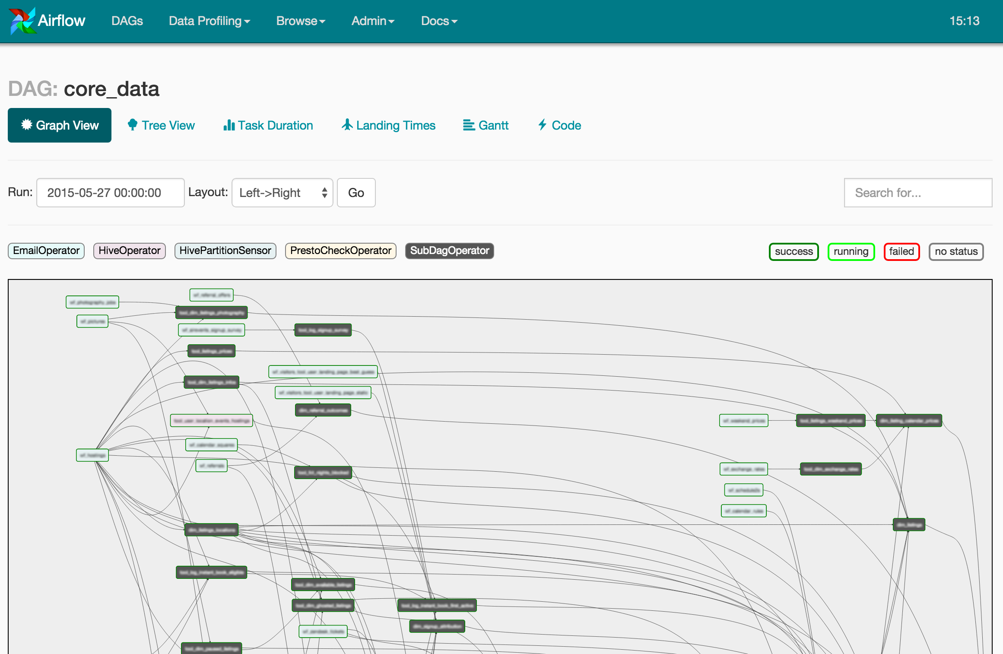
Scheduling with Airflow
I like to know when jobs fail.
I like to version control my tasks
I like to know how long jobs take
I like one task to start another
I like pretty pictures….

Slide 58
Scheduling with Airflow
I now have Embulk Dependencies
from airflow import DAG
from airflow.operators.bash_operator import BashOperator
from datetime import datetime, timedelta
default_args = {
'owner': 'airflow',
'depends_on_past': False,
'start_date': datetime(2019, 4, 1),
'email': ['jason.bell@equidatagroup.com'],
'email_on_failure': False,
'email_on_retry': False,
'retries': 1,
'retry_delay': timedelta(minutes=5),
}
dag = DAG('embulk_demo', default_args=default_args, schedule_interval=timedelta(days=1))
t1 = BashOperator(
task_id='file_mysql_import',
bash_command='embulk run /home/jason/embulkscripts/scenario1/config.yml',
params={ "-c": "/home/jason/embulkscripts/scenario1/diff.yml"},
dag=dag)
t2 = BashOperator(
task_id='mysql_redshift',
bash_command='embulk run /home/jason/embulkscripts/scenario2/config.yml',
params={ "-c": "/home/jason/embulkscripts/scenario2/diff.yml" }
retries=3,
dag=dag)
t1 >> t2

Slide 59
Failed Transaction Recovery
The -r flag gives you transaction failure recovery.
$embulk run config -r resume-state.yml
$embulk cleanup config.yml -r resume-state.yml

Slide 60
Key Takeaways
Easy to install
Easy to setup input/output jobs
Will guess input file formats
Well maintained plugin system
Works well within Crontab or Airflow
Website: https://www.embulk.org/docs

Slide 61


Rate today ’s session
Session page on conference website
O’Reilly Events App

Slide 62

Thank you.
Addition Q&A will be available in London City Airport Departure Lounge
@jasonbelldata - @deskhoppa - https://www.deskhoppa.com

